Slide 1



Slide 2
AGENDA
Future
Work
Introduction
>
Architecture
>
Contribution
>
Major Challenge
Features, Architecture Design
Built Web Application

Slide 3
Architecture Design
Figure out Functions/Features for our tool/web application
User Login/Register
Get the trending Youtube videos
For new youtuber, get some key points for first video
Take youtuber’s feature parameters as input and make predictions about the popularity
(Advanced Features) Take youtuber’s new videos as input and make predictions based the user’s video history and dataset about the popularity
Data Science Algorithm
Web Server
Backend Server
User
Database

Slide 4
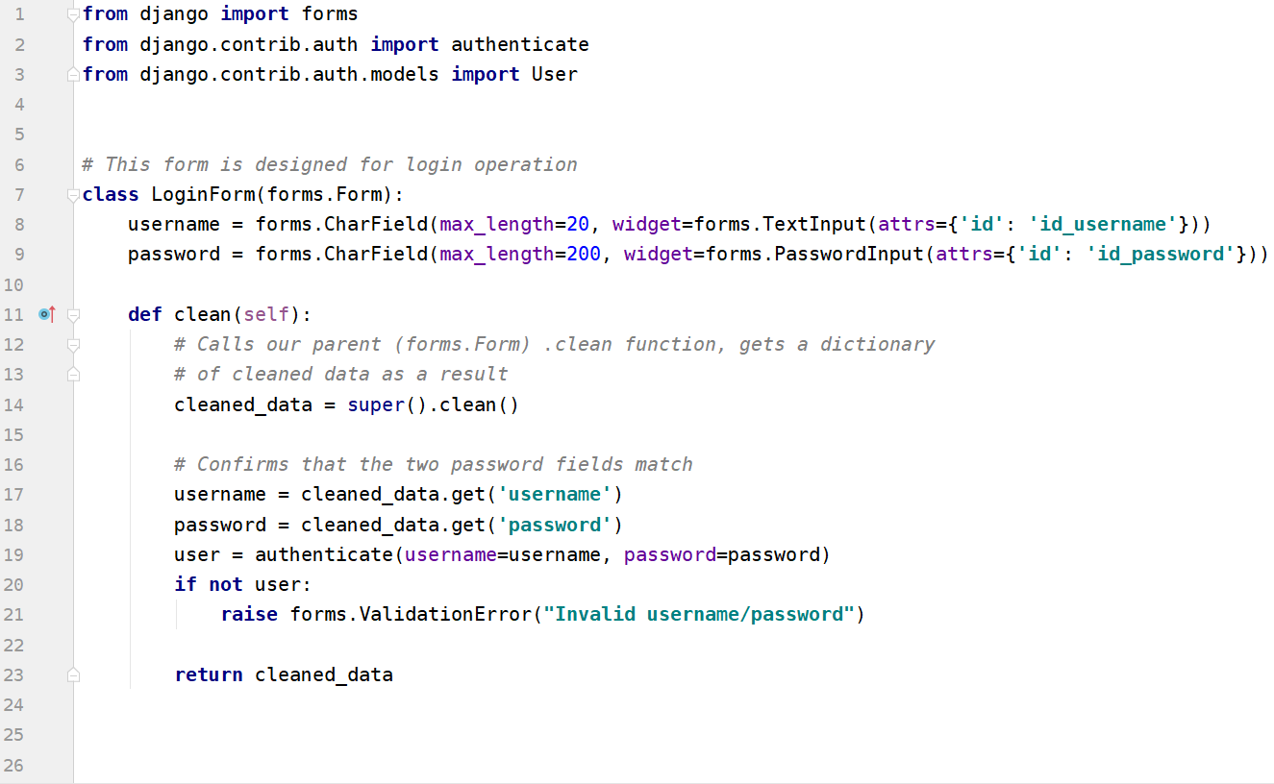
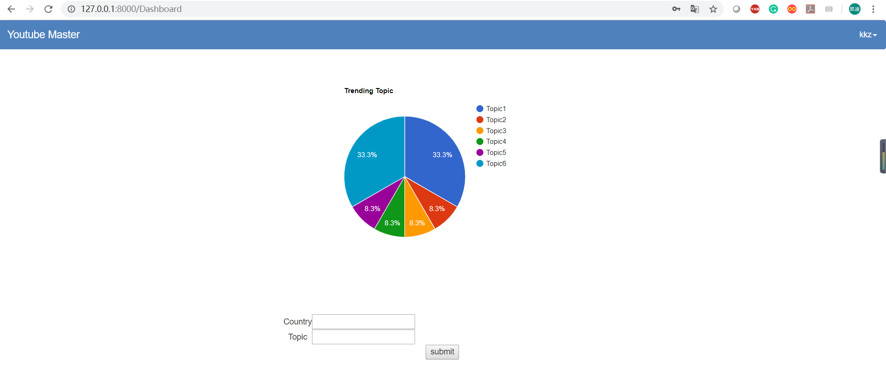
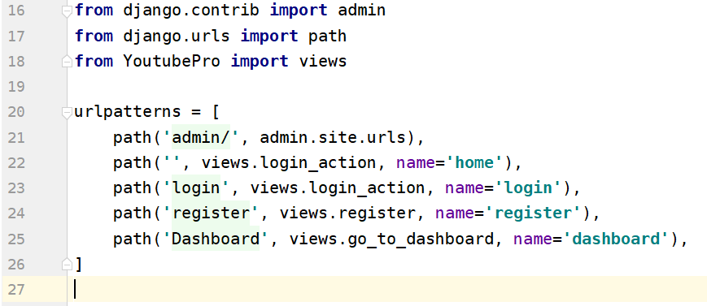
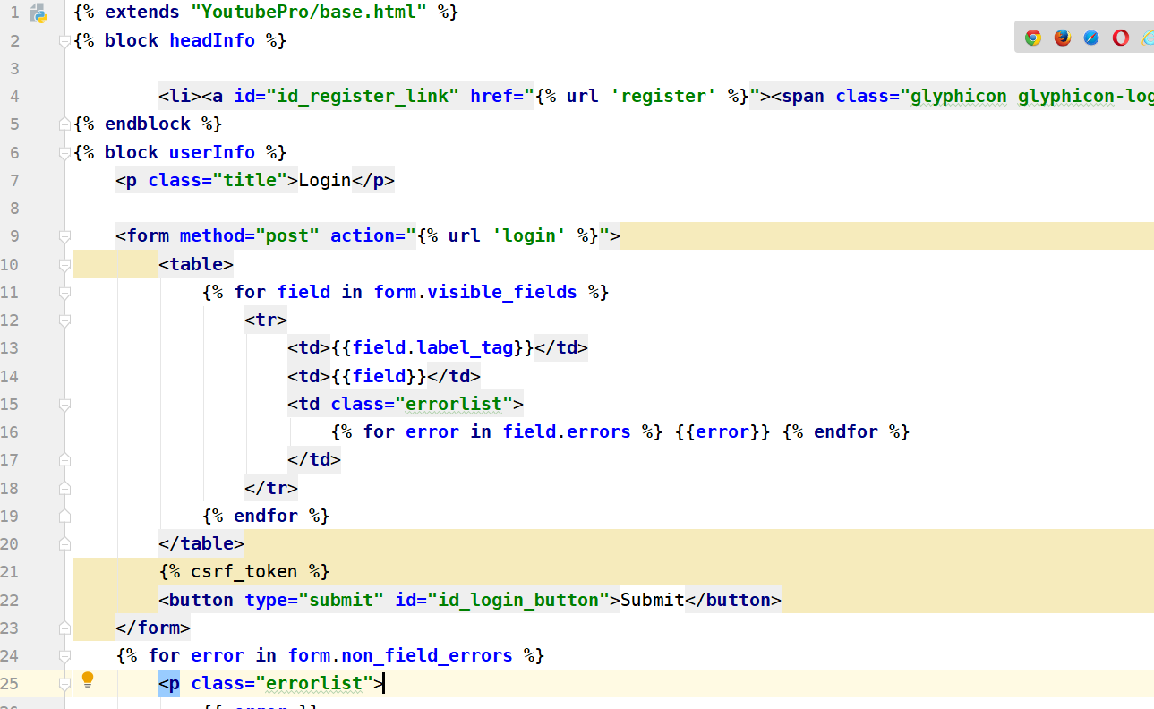
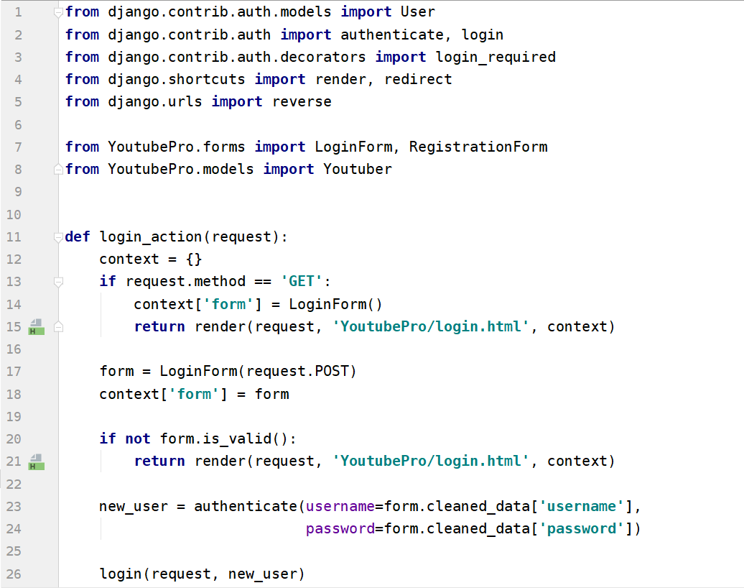
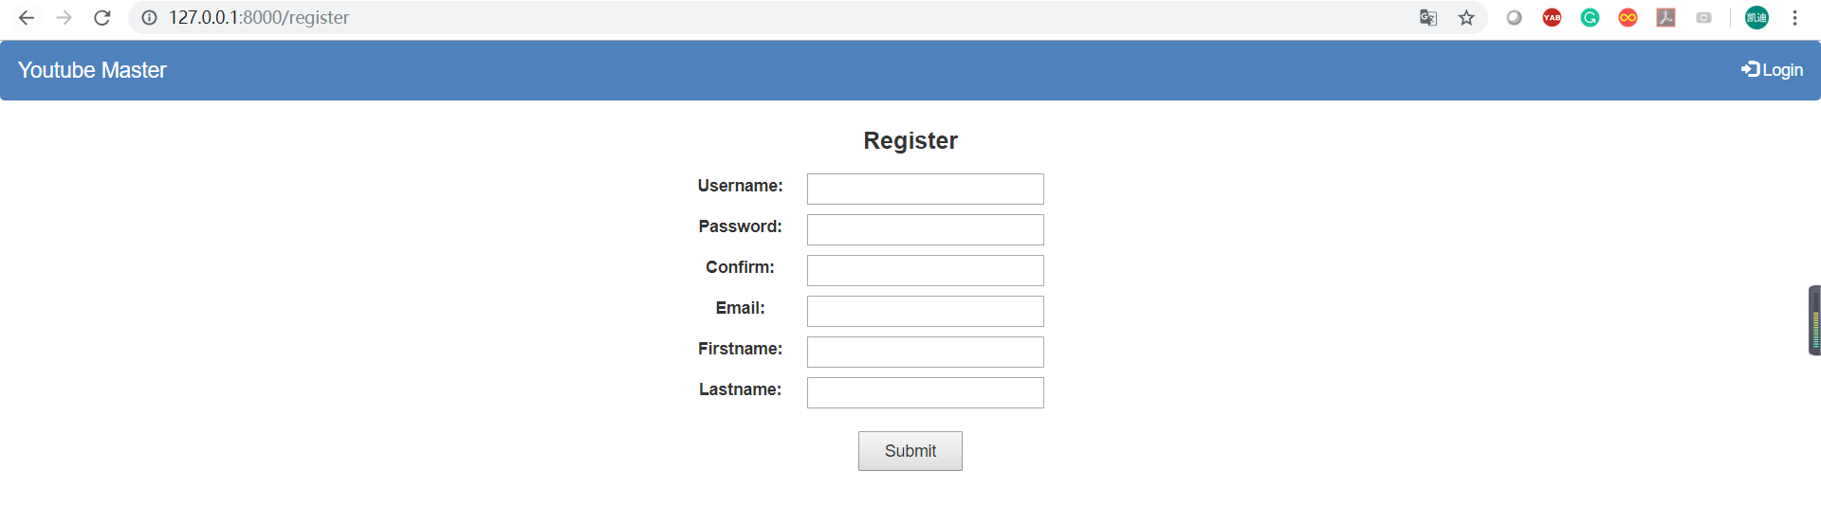
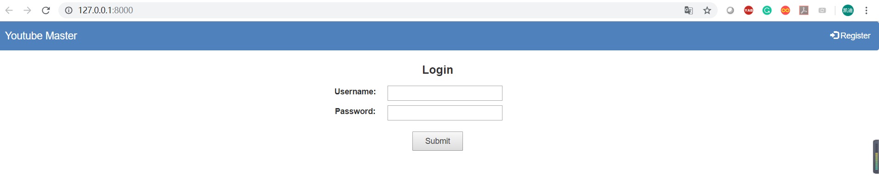
Personal Contribution
Set up the web application using Django 2.1.5
Designed the url path for web application
Completed the template files for base, login, register and dashboard
Wrote a basic style for the base.html
Defined the LoginForm, RegisterForm and basic user model
Implemented the functions in views for login, register and redirect function

Slide 5
Future Work
Finish the remaining features
Deploy the application on the cloud like EC2
Using Message Queue to make response asynchronous in order to give a better user experience
Use cache to reduce the load operation for database and improve the performance
Considering the availability and scalability for our system
Data Science Algorithm
Web Server
Backend Server
User
Database
Message Queue
Custom end cache
Database
Database
Email
cache

